Slide 1





MI ECOMMERCE
Grupo 7

Slide 2


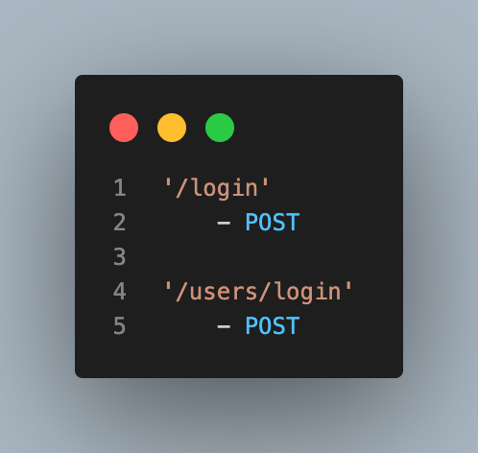




ENDPOINTS LOGIN
Hernan Gutierrez

Slide 3



Diego
Perez
Ballester
Bermudez
Federico
Sierra
Hernan
Gutierrez
Juan
Ventura

Slide 4





Slide 5






JAVASCRIPT
NPM
GIT
JWT
VSCODE
NODEJS
EXPRESS
SWAGGER
POSTMAN

Slide 6




Slide 7

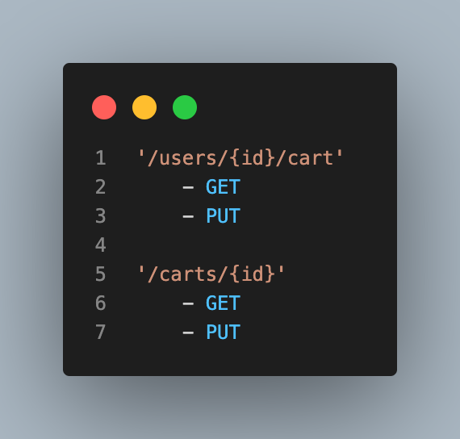

ENDPOINTS CARTS
MODULARIDAD
Diego Perez

Slide 8
ENDPOINTS LOGIN
Hernan Gutierrez

Slide 9
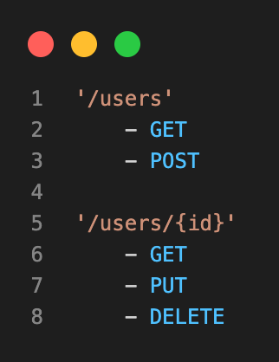

ENDPOINTS USERS
Federico Sierra

Slide 10
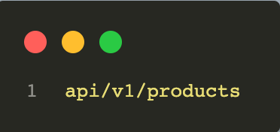
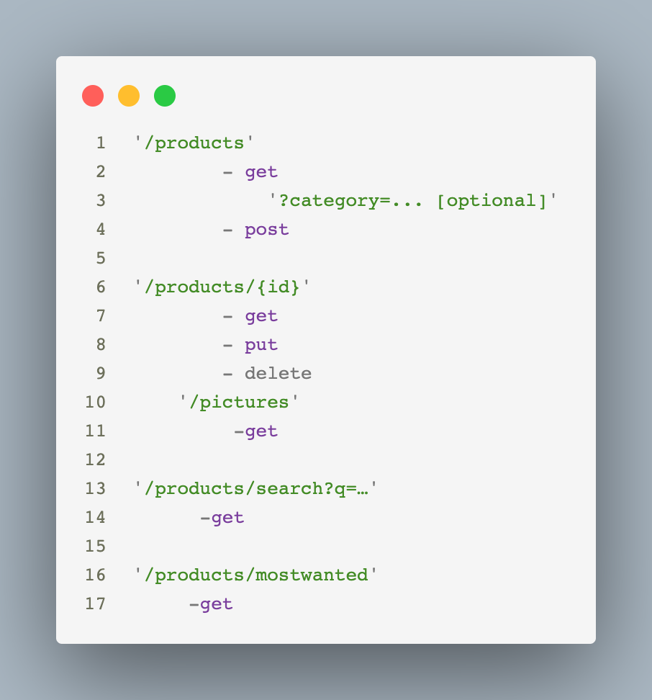





ENDPOINTS PRODUCTS
/products
- get
?category=... [optional]
- post
/products/{id}
- get
- put
- delete
/pictures
-get
/products/search?q=…
-get
/products/mostwanted
-get
Juan Ventura

Slide 11
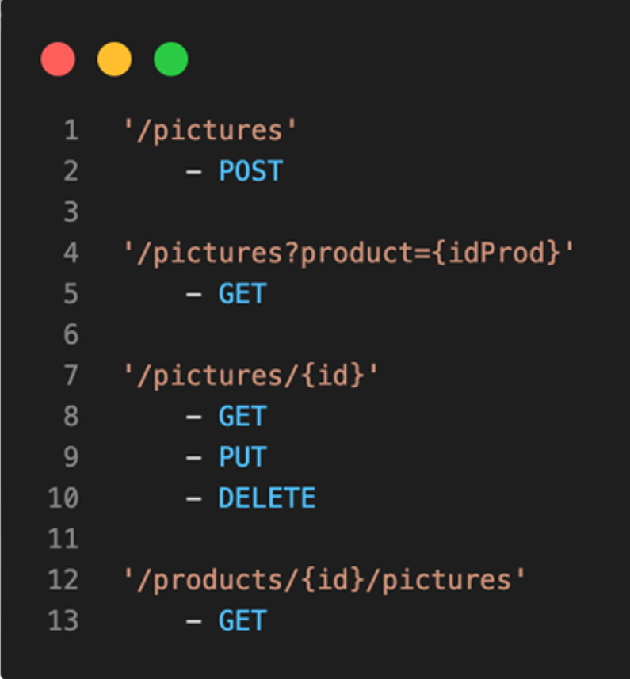

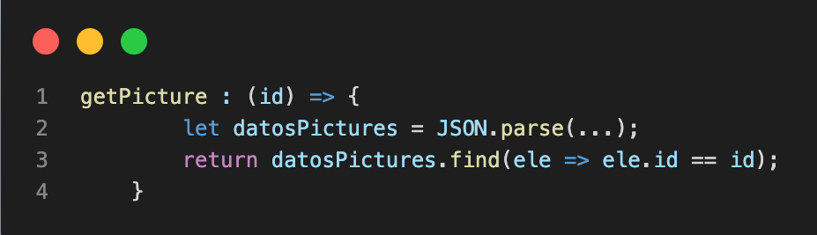
ENDPOINTS PICTURES
Ballester Bermudez

Slide 12
ENDPOINTS CARTS
Diego Perez

Slide 13

ENDPOINTS CARTS
Diego Perez

Slide 14
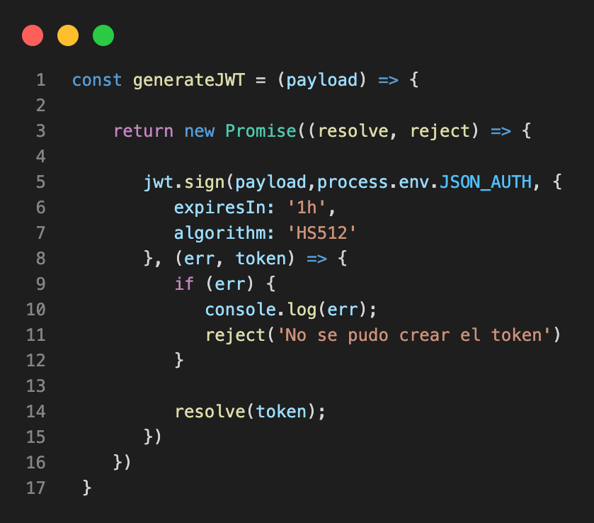

JSONWEBTOKEN

Slide 15
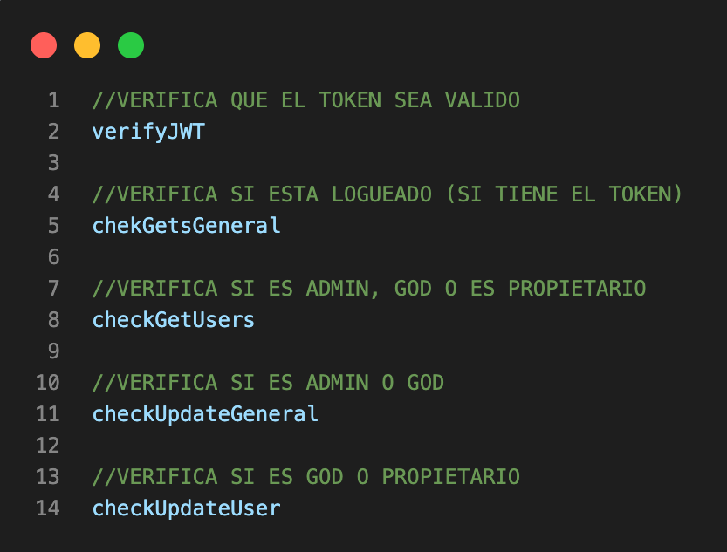

Middlewares

Slide 16


Slide 17




